Slide 1
Lecture 24: What’s Next?
Prof. Austin
Environmental Economics Econ 4075

Slide 2
What’s Next?
Outline:
West Virginia v. EPA
Bipartisan Infrastructure Law
Inflation Reduction Act

Slide 3
Part 1: West Virginia vs. EPA

Slide 4
Policy Legal Vulnerability
Policymakers pursue their regulatory agenda based on many factors:
Political direction from the elected president & their constituency.
Whether a new rule is likely to be enduring.
Time, resources, and labor effort.
A common source of policy vulnerability is legal challenge. Corporations and environmental groups sue EPA over almost every major action.

Slide 5

Chevron vs. Natural Resources Defense Council
Under the Clean Air Act amendments of 1977, major modifications to existing plants were “new sources” and could go through New Source Review.
In 1981, the Reagan administration re-defined “new source” to mean an entirely new facility.
NRDC successfully sued EPA in the DC circuit, saying EPA had capriciously changed its own definition.
Chevron then appealed to the Supreme Court, which ruled unanimously 6-0 in favor of Chevron.
RBG wrote the initial opinion on the NRDC case while serving as a DC circuit court judge. Image source.
Notes:
The Chevron case has been cited thousands of times and is one of the most important supreme court decisions.

Slide 6
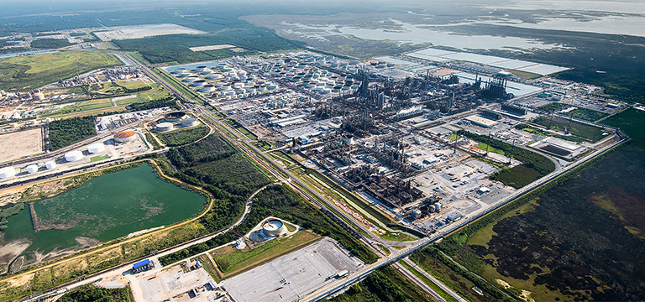
Aside: The Chevron Pascagoula Refinery, Mississippi
Image source.
Notes:
The facility has been in operation since 1963. It sits on over 3,000 acres adjacent to the Mississippi Sound.

Slide 7
Chevron vs. Natural Resources Defense Council
“When a challenge to an agency construction of a statutory provision, fairly conceptualized, really centers on the wisdom of the agency's policy, rather than whether it is a reasonable choice within a gap left open by Congress, the challenge must fail. In such a case, federal judges—who have no constituency—have a duty to respect legitimate policy choices made by those who do. The responsibilities for assessing the wisdom of such policy choices and resolving the struggle between competing views of the public interest are not judicial ones ....”
— Chevron, 467 U.S. at 866

Slide 8
The Chevron Doctrine
Some language in environmental laws is clear, but it is often ambiguous. Ambiguity makes environmental policies vulnerable to the political persuasion of judges. The Chevron vs. NRDC case created a precedent for judges and a clearer separation of powers.
Chevron deference: When reviewing an agency's action over ambiguous sections of statute, jurists should defer to the agency’s understanding of laws that Congress directed the agency to administer.
See more from the NRDC on a current case that could officially overturn Chevron.

Slide 9
Background on WV vs. EPA
Prior events:
Massachusetts vs. EPA
EPA has authority to regulate GHGs. If GHGs are harmful, then EPA cannot delay issuing vehicle emissions standards for GHGs.
GHG Endangerment Finding (2009): six GHGs are harmful to public health and welfare.
New heavy and light duty vehicle emissions standards
The 2015 Clean Power Plan would have reduced GHG emissions from existing power plants and shifted generation to cleaner sources. It gave states the authority to implement these standards and design a wide variety of programs, including allowance trading, to meet the GHG goals.
Read an NRDC article summary of the CPP.

Slide 10
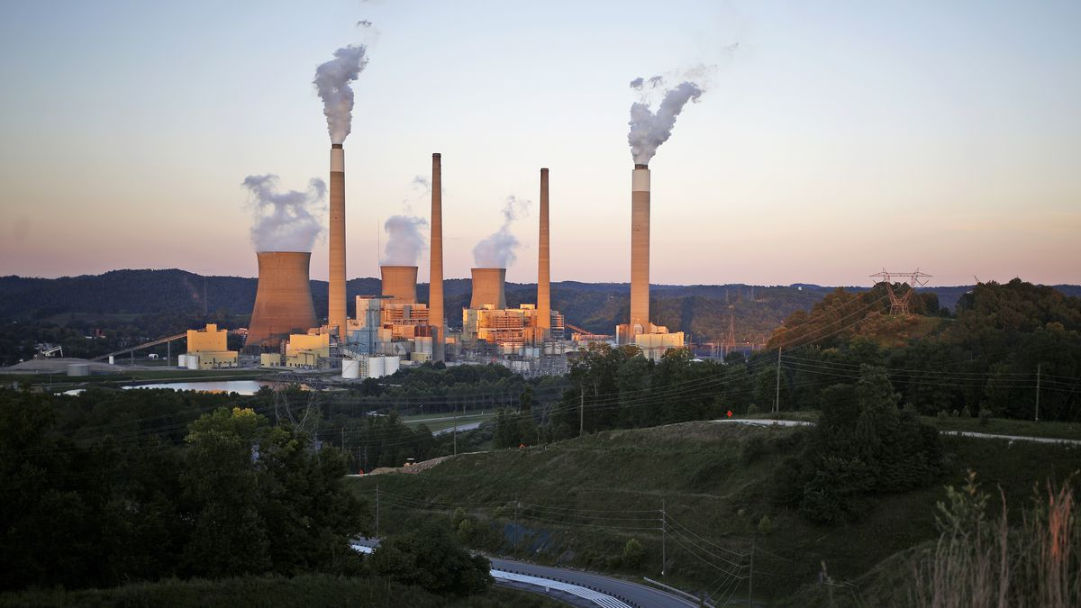
West Virginia vs. EPA
States and power companies sued EPA for over-reach in the CPP, alleging that generation shifting was not a valid best technology that could be used to meet EPA’s standards.
Congress/CAA permits emission standards based on “best technologies” within the fenceline.
Generation shifting applies to an entire state electricity sector, hence regulating “beyond the fenceline” of the air pollution source.
The Winfield coal-fired power plant in West Virginia. Source: Vox “A new Supreme Court case could gut the government’s power to fight climate change” (2021)

Slide 11
Merits of Each Side
Shortcomings in the petitioner’s argument:
Clean Power Plan never implemented, so no standing to sue EPA.
Invocation of major questions doctrine goes against judicial precedent in Chevron doctrine.
Shortcomings in the EPA defense:
CPP and generation shifting was cost-benefit justified ($22.6b net benefits), but this fact was not used to justify the selected standard (see Cecot, 2022).
Led to criticism that CPP was not science-based and EPA would set standards “wherever the Agency sees fit.”

Slide 12
Long-Term Concerns
SCOTUS ruled in favor of WV. Many concerns with the ruling have been expressed, but a few big ones:
Precedent to invoke major questions doctrine implies significant regulations will be over-turnable by courts, including past regulations.
Increased uncertainty around delegated powers weakens agency flexibility and ability to act quickly, pushes many actions back to Congress.
Unclear if congressional authority to delegate also impacted.
Prohibiting regulation “beyond the fenceline” through the CAA limits the potential range of regulatory options for GHGs.
Generation shifting often much cheaper than other GHG abatement, so weakens reduction options set for new or existing plants.

Slide 13
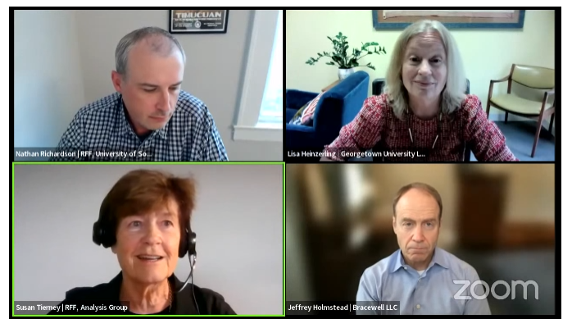
RFF Session
Two questions uncertain:
How far-reaching is the ruling?
Holmstead: narrowly affects power generation shifting.
Heinzerling: potentially affects all future agency actions not limited to climate change.
Elected congress, unelected bureaucrats, or unelected judges?
Link to RFF Event video.

Slide 14
Part 2: Bipartisan Infrastructure Law

Slide 15
Main Provisions of the Bipartisan Infrastructure Law
Massive $550b over 10 years. Environmentally-relevant portions of the BIL:
$90b for newer buses, trains, and transit stops
$66b for more and cleaner passenger rail
$65b grid modernization and clean energy transmission
$55b to eliminate lead pipes
$50b flood, drought, wildfire, etc. preparedness
$21b to clean Superfund and brownfield sites
$7.5b for national network of 500,000 EV chargers
$5b for 24,000 electric school buses

Slide 16
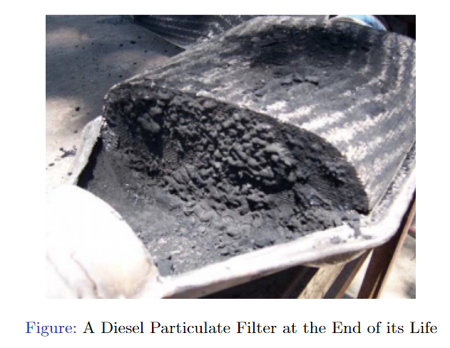
Electrification of Buses
Some benefits of electrifying school buses:
Reduced visits to hospitals and clinics for children and adults (Beatty and Shimshack, 2011).
Aerobic capacity and test scores (Austin et al, 2019).

Slide 17
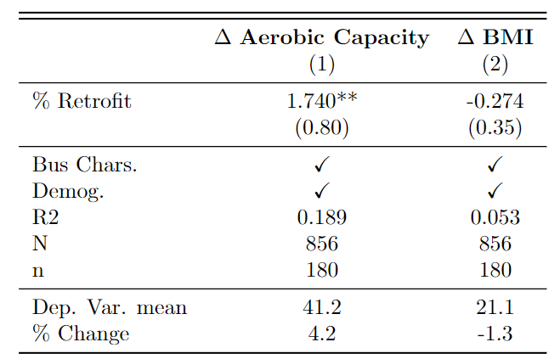
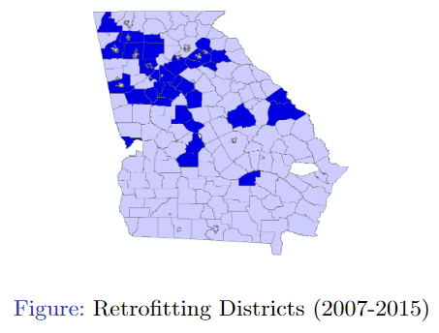
Aerobic Capacity (VO2 Max)
Natural experiment on school bus retrofits:
2,600 buses retrofitted in Georgia 2007-2015 (150,000 students).

Slide 18
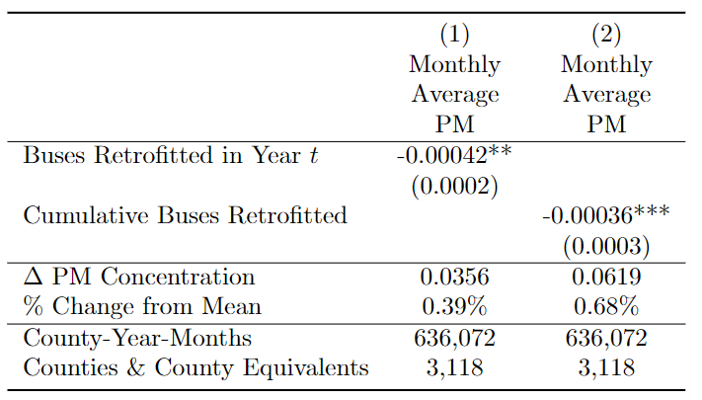
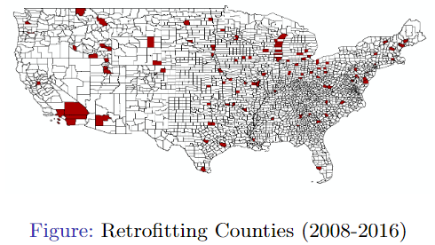
Satellite-based PM 2.5
National version:
18,000 buses retrofitted nationally 2008-2016 ($170m)

Slide 19
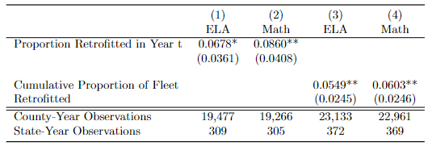
Test Scores
Also, sizeable impact on academic performance for both language arts and math test scores.
PM 2.5 benefits would have been $245m.
Test score benefits, where 1 percentile increase is $1,041 extra income after discounting implies $4.5B benefit.

Slide 20
Part 3: Inflation Reduction Act

Slide 21
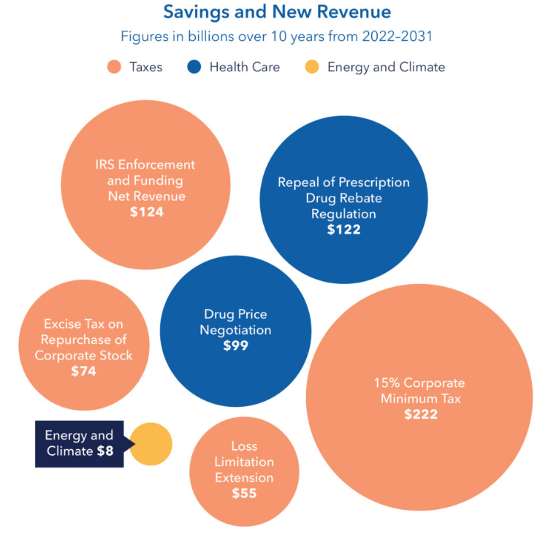
Why is it called the Inflation Reduction Act?
The IRA is a budget reconciliation bill, which makes it easier to pass because no susceptibility to filibuster and only 50(+1 VP) votes needed.
Reduces the deficit by $238 billion over a decade (CBO, 2022).
General agreement that the bill has minimal effect on inflation.
Some uncertainty if increase or decrease (CBO, 2022).
Methane fee, superfund tax.

Slide 22
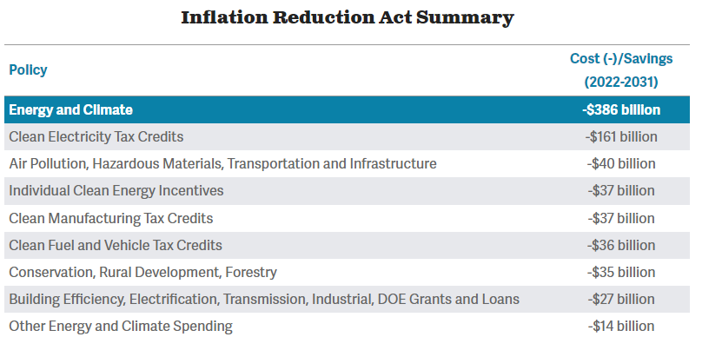
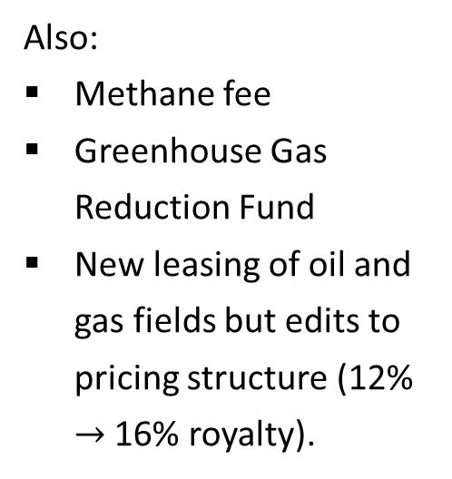
Main Provisions
Also:
Methane fee
Greenhouse Gas Reduction Fund
New leasing of oil and gas fields but edits to pricing structure (12% $→$ 16% royalty).
Figure source.

Slide 23
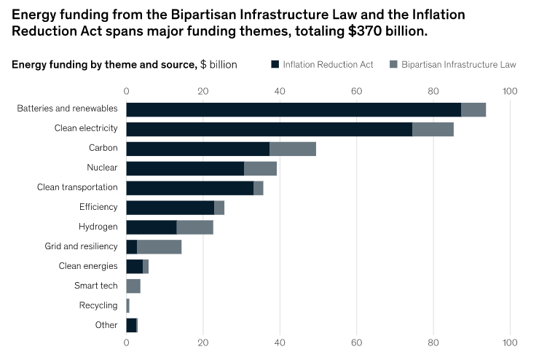
IRA vs. BIL for Climate
Source: McKinsey and Company, 2022.

Slide 24
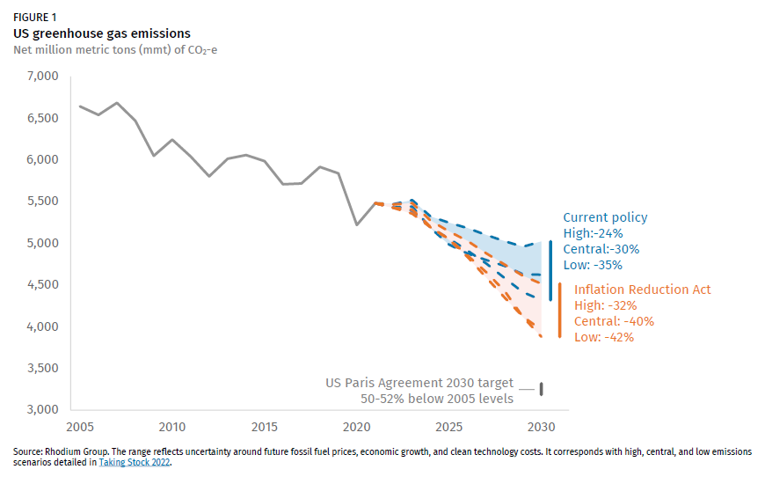
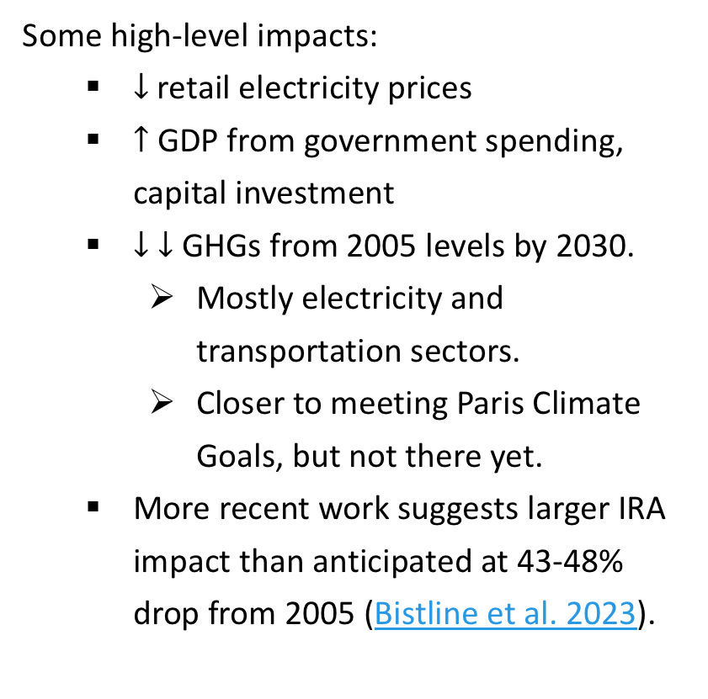
Long-term Impact?
Some high-level impacts:
$↓$retail electricity prices
$↑$ GDP from government spending, capital investment
$↓$ $↓$ GHGs from 2005 levels by 2030.
Mostly electricity and transportation sectors.
Closer to meeting Paris Climate Goals, but not there yet.
More recent work suggests larger IRA impact than anticipated at 43-48% drop from 2005 (Bistline et al. 2023).
Figure source.

Slide 25
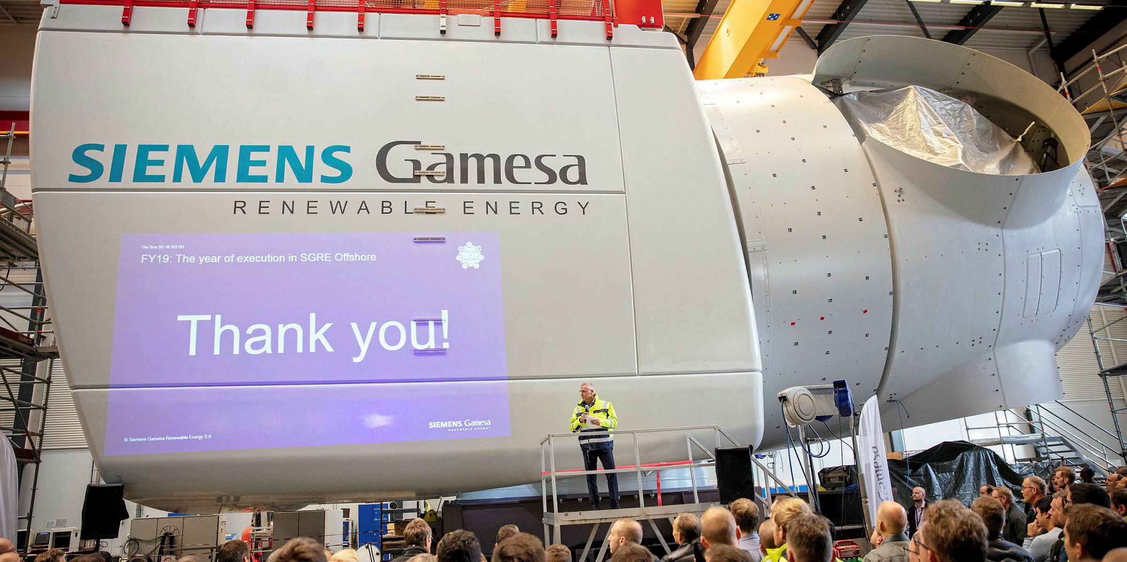
Clean Energy Tax Credits
Extension of clean energy tax credits to 2025, then technology neutral renewables credits after.
Production tax credit ($5/MWh)
Investment tax credit (6% on investment)
Other major tax credits:
Hydrogen and nuclear tax credits.
$85 per ton tax credit for carbon capture.
Figure: Newest Siemens Gamesa windmills have a propeller spread of 240 meters and costs $13-20 million (Image source).
Notes:
6% of a 13m windmill = $780,000

Slide 26
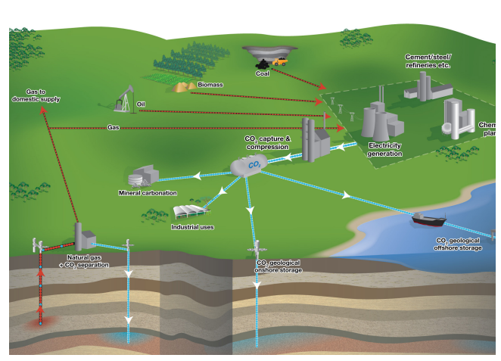
Carbon Capture and Sequestration
CCS dramatically lowers GHGs emissions overall, but also increases burning of fossil fuels to power CCS tech itself and continues operation. Mixed effects:
Some GHGs from transporting additional fossil fuels unless clean transport
More PM, NOx
Threefold increase in local ammonia due to solvents that capture CO2.
Source: European Environment Agency, 2011

Slide 27
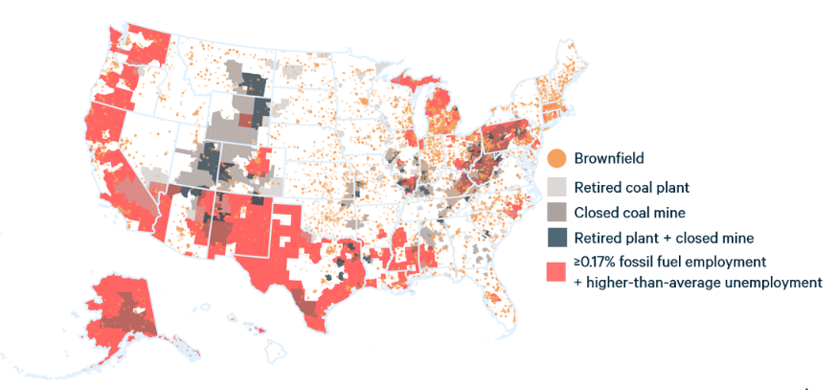
Energy Communities
Special consideration given to “energy communities.”
Bonus tax credits ($0.50) for electricity production
Bonus tax credits 6 – 16% on investments in electricity production
Increased political support, notions of fairness, and also extent of subsidy.

Slide 28
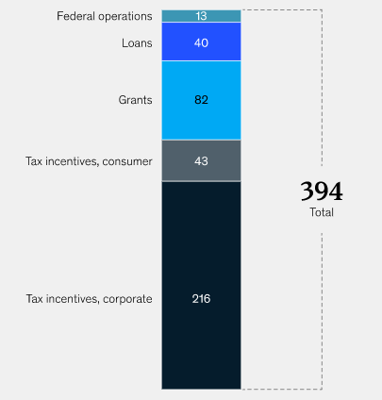
Consumer Tax Credits
Roughly $43 billion in tax credits directly to consumers:
Heat pumps and electric water heaters (capped at $2000)
Rooftop solar (up to 30% of cost, capped at $1200 total)
Electric vehicles ($7500 for new and $4000 for used EVs)
Source: McKinsey and Company, 2022.

Slide 29
Who Benefits from Clean Energy Tax Credits?
Consumer tax credits benefit wealthiest income quintiles (Borenstein and Davis, 2016). Using tax return data on home weatherization, hybrid/electric vehicles and solar panel credits:
Top quintile received 60% of benefits, bottom three 10%.
Top quintile received 90% of all credits for electric vehicles.
Explanation: renters aren’t eligible for home upgrades, share of taxpayers that file vs. receive automatic deduction.

Slide 30
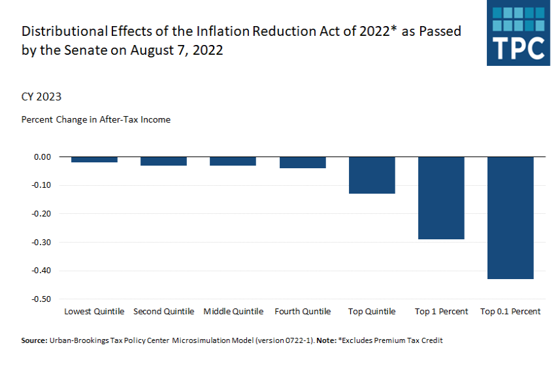
Who Pays?
Link.

Slide 31
Greenhouse Gas Reduction Fund
The IRA created a new national climate bank, the Greenhouse Gas Reduction Fund ($27B) that provides competitive grants for clean energy and climate-related projects that reduce GHGs.
$7b for distributed zero-emission electricity production to low-income communities such as solar rooftop grants
$20b in financial assistance in competitive grants for projects that reduce GHGs ($8b specifically for low-income communities).

Slide 32
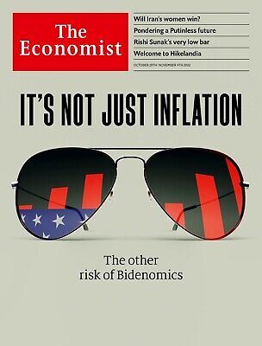
Controversy
The IRA and BIL have been criticized by various groups.
“Bidenomics” industrial policy, at 0.7% of GDP, is more dirigiste than France.
Inflation, inefficiency?
Protectionism of US firms through Buy America policies.
Other countries could subsidize their firms too.

Slide 33
Next class
Wednesday’s class will feature a review game for the final. There are no required readings, but please start studying for the final next Monday.

